Slide 1


知识表示学习及其应用
第二届大数据在清华论坛
刘知远
清华大学自然语言处理实验室
liuzy@tsinghua.edu.cn

Slide 2
大数据与信息检索
信息过载
信息检索

Slide 3
搜索引擎的辉煌20年
Google （1998-）
百度（2000-）

Slide 4
从字符串到实体
“Things, Not Strings”

Slide 5
谷歌知识图谱

Slide 6
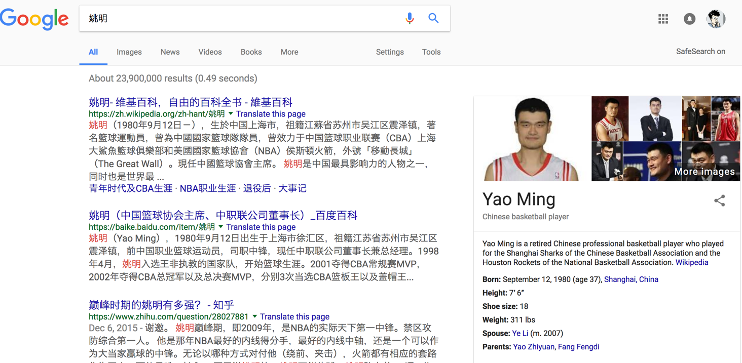
知识图谱应用：搜索引擎
Notes:
在谷歌中，搜索obama，在右侧中可以显示出与之有关的各种属性，例如出生时间，地点，配偶等关系。以往的检索的内容只能够提供包含字符串“obama”的网页，信息需要用户自己去阅读，这种基于知识图普的检索方式，大大提升了效率和准确性。

Slide 7
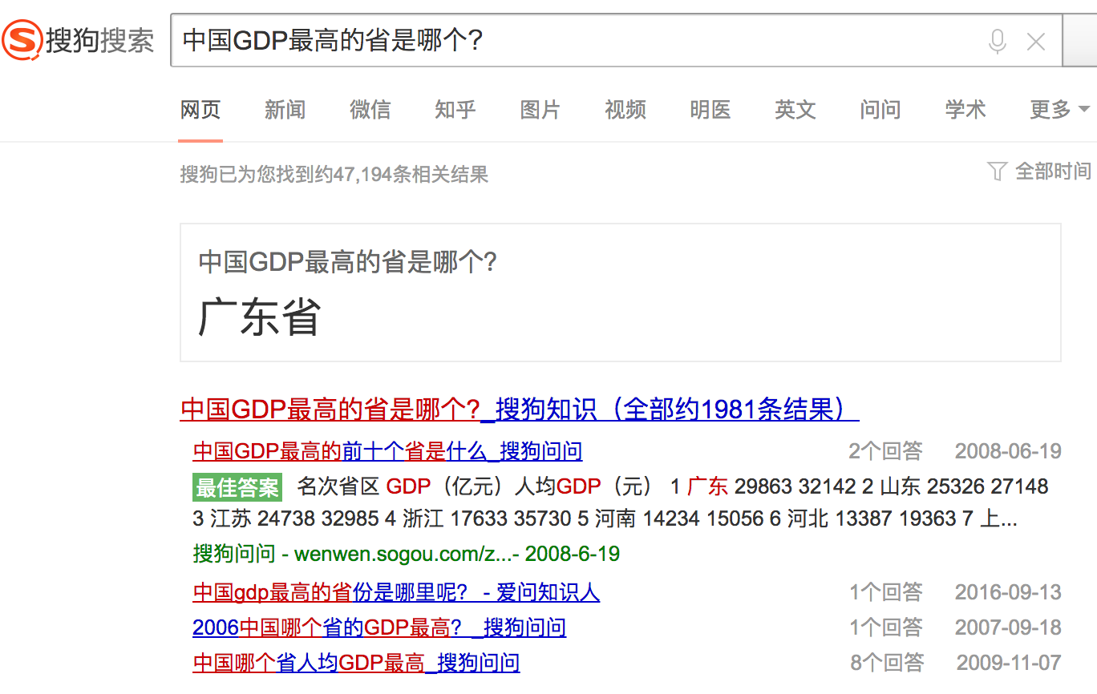
知识图谱应用：智能问答

Slide 8
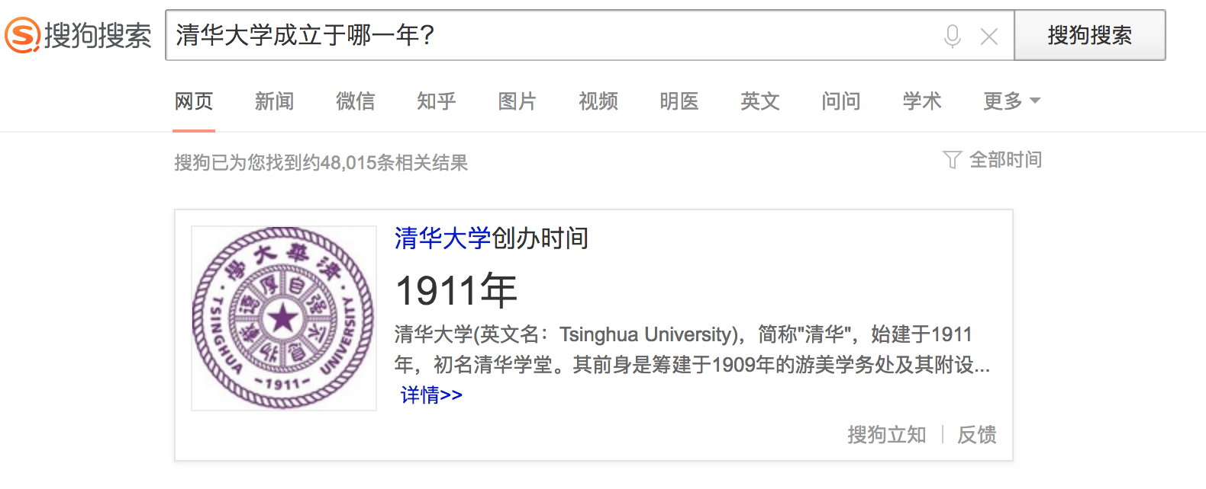
知识图谱应用：智能问答

Slide 9
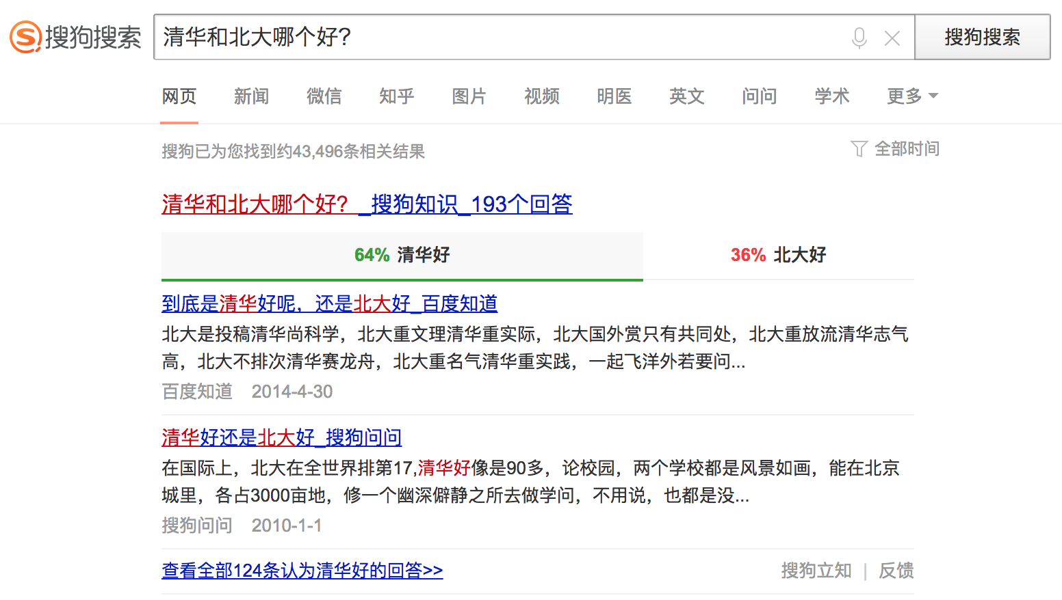
知识图谱应用：智能问答

Slide 10
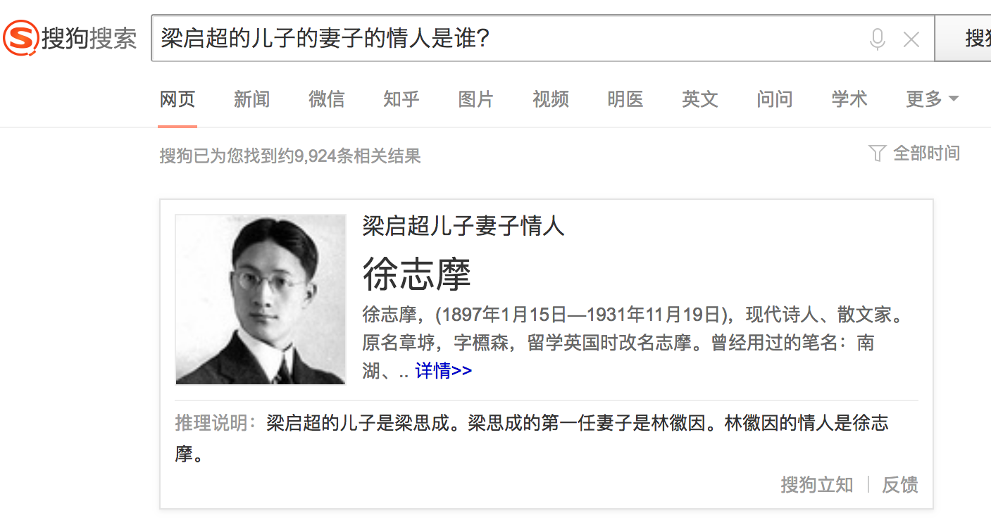
知识图谱应用：智能问答

Slide 11
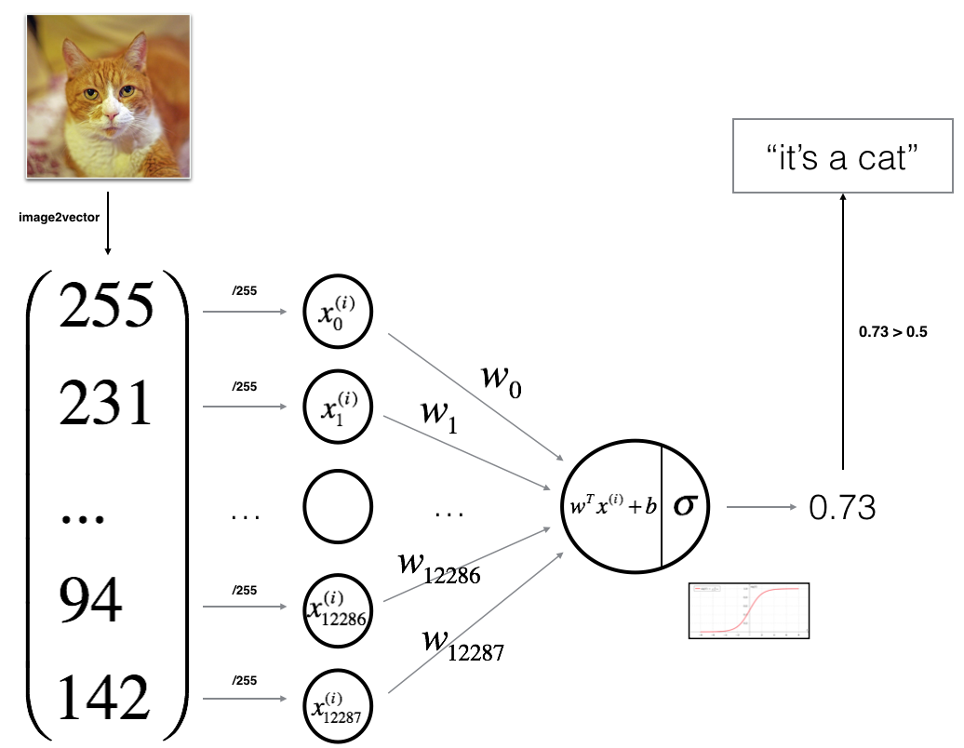

符号表示
猪
[0, 0, 0, 0, 0, 0, 0, 0, 1, 0, 0, 0, 0, …]
狗
[0, 0, 0, 0, 0, 0, 0, 1, 0, 0, 0, 0, 0, …]
单词 | ONEHOT表示
LOVE | [0, 0, 0, 0, 0, 0, 0, 0, 1, 0, 0, 0, 0, …]
YOU | [0, 0, 0, 0, 0, 0, 0, 1, 0, 0, 0, 0, 0, …]
sim(star, sun) = 0

Slide 12
分布式表示
Distributed Representation
对象均被表示成稠密、实值、低维向量

Slide 13
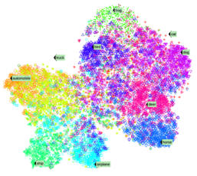
分布式表示的优势
解决大数据处理（如NLP）的数据稀疏问题
实现跨领域、跨对象的知识迁移
提供多任务学习的统一底层表示
知识
语义分析
文档
句法分析
句子
词法分析
词汇
统一语义空间

Slide 14
知识表示学习

Slide 15
知识表示的挑战
知识图谱的典型表示方案
基于符号表示的三元组（RDF）
无法有效计算实体间的语义关系
解决方案：将知识映射到低维向量空间

Slide 16
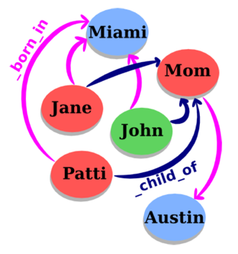
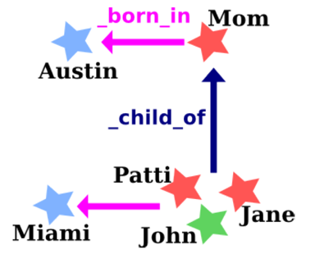
TransE: 将关系表示为平移
对每个事实 (head, relation, tail)，将其中的relation作为从head到tail的平移操作

Slide 17
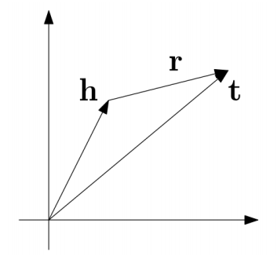
TransE: 将关系表示为平移
对每个事实 (head, relation, tail)，将relation作为从head到tail的平移操作
优化目标: h + r = t

Slide 18

评价任务：链接预测
WALL-E
_has_genre
?

Slide 19
评价任务：链接预测
WALL-E
_has_genre
Animation
Computer animation
Comedy film
Adventure film
Science Fiction
Fantasy
Stop motion
Satire
Drama
Connecting

Slide 20
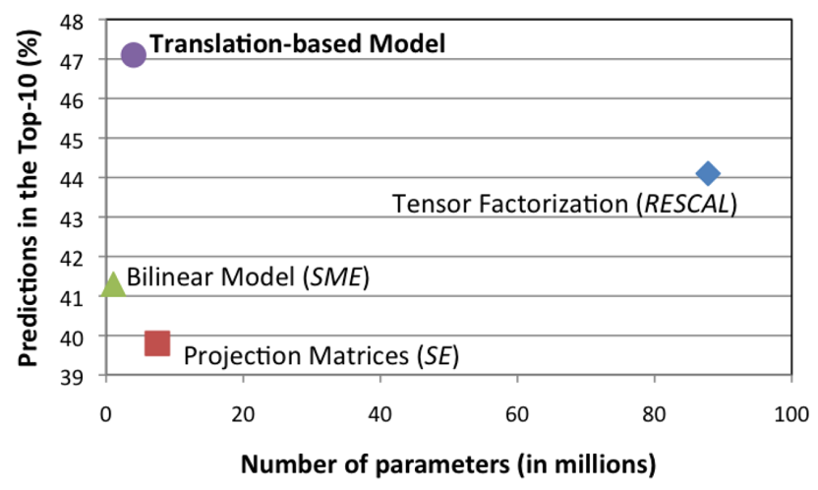
链接预测性能比较
Freebase15K

Slide 21
TransE样例
Entity | Tsinghua_University | A.C._Milan
1 | University_of_Victoria | Inter_Milan
2 | St._Stephen's_College,_Delhi | Celtic_F.C.
3 | University_of_Ottawa | FC_Barcelona
4 | University_of_British_Columbia | Genoa_C.F.C.
5 | Peking_University | Udinese_Calcio
6 | Utrecht_University | Real_Madrid_C.F.
7 | Dalhousie_University | FC_Bayern_Munich
8 | Brasenose_College,_Oxford | Bolton_Wanderers_F.C.
9 | Cardiff_University | Borussia_Dortmund
10 | Memorial_University_of_Newfoundland | Hertha_BSC_Berlin

Slide 22
TransE样例
Entity | China | Barack_Obama | Apple
1 | Japan | George_W._Bush | Onion
2 | Taiwan | Nancy_Pelosi | Strawberries
3 | South_Korea | John_Kerry | Avocado
4 | Argentina | Hillary_Rodham_Clinton | Pear
5 | North_Korea | Al_Gore | Cabbage
6 | Hungary | George_H._W._Bush | Broccoli
7 | Israel | John_McCain | Egg
8 | Australia | Colin_Powell | Cheese
9 | Iceland | Bill_Clinton | Bread
10 | Hong_Kong | Charles_B._Rangel | Tomato

Slide 23
TransE样例
Relation | /people/person/nationality | /location/location/contains
1 | /people/person/places_lived | /base/aareas/schema/administrative_area/administrative_children
2 | /people/person/place_of_birth | /location/country/administrative_divisions
3 | /people/person/spouse_s | /location/country/first_level_divisions
4 | /base/popstra/celebrity/vacations_in | /location/country/capital
5 | /government/politician/government_positions_held | /award/award_nominee/award_nominations
6 | /people/deceased_person/place_of_death | /location/administrative_division/capital
7 | /olympics/olympic_athlete/country | /location/us_county/county_seat
8 | /olympics/olympic_athlete/medals_won | /base/aareas/schema/administrative_area/capital
9 | /music/artist/origin | /location/us_county/hud_county_place
10 | /people/person/employment_history | /award/award_winner/awards_won

Slide 24
TransE样例
Head | China | Barack_Obama
Relation | /location/location/adjoin | /education/education/institution
1 | Japan | Harvard_College
2 | Taiwan | Massachusetts_Institute_of_Technology
3 | Israel | American_University
4 | South_Korea | University_of_Michigan
5 | Argentina | Columbia_University
6 | France | Princeton_University
7 | Philippines | Emory_University
8 | Hungary | Vanderbilt_University
9 | North_Korea | University_of_Notre_Dame
10 | Hong_Kong | Texas_A&M_University

Slide 25
TransE样例
Head | Stanford_University | Apple | Titanic
Relation | /education/educational_institution/students_graduates | /food/food/nutrients | /film/film/genre
1 | Steven_Spielberg | Lipid | War_film
2 | Ron_Howard | Protein | Period_piece
3 | Stan_Lee | Valine | Drama
4 | Barack_Obama | Tyrosine | History
5 | Milton_Friedman | Serine | Biography
6 | Walter_F._Parkes | Iron | Film_adaptation
7 | Michael_Cimino | Cystine | Adventure_Film
8 | Gale_Anne_Hurd | Pantothenic_acid | Action_Film
9 | Bryan_Singer | Vitamin_A | Political_drama
10 | Aaron_Sorkin | Sugar | Costume_drama

Slide 26
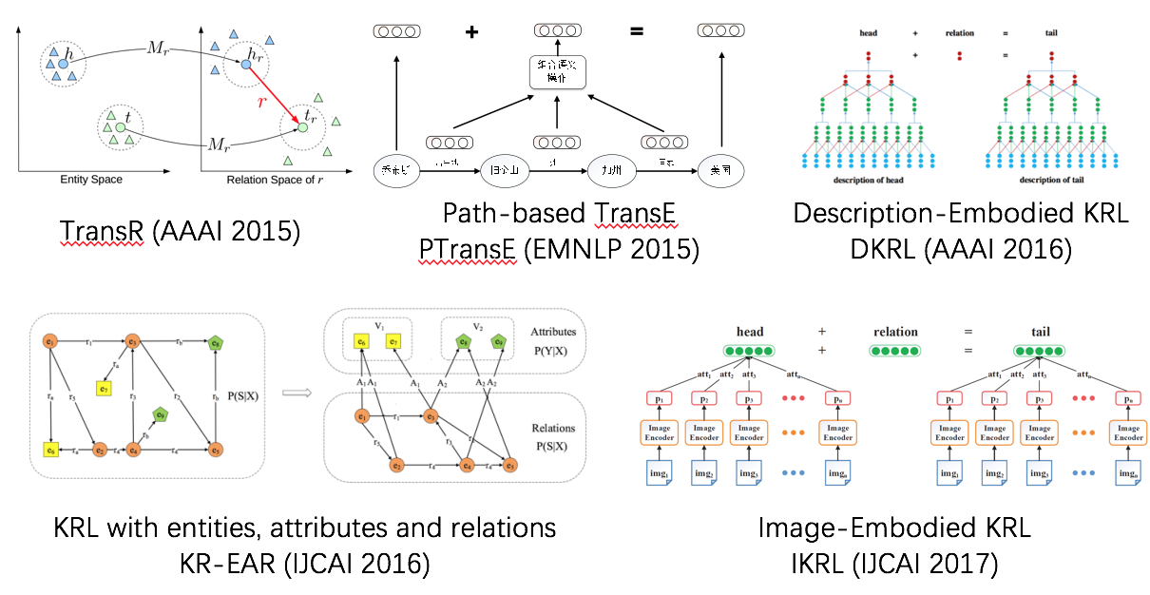
知识表示学习改进技术

Slide 27
知识表示学习相关应用

Slide 28
关系抽取
基于知识图谱的关系预测
基于文本信息的关系预测
r ~ t-h
Founder
Bill Gates
Microsoft
Bill Gates
was the co-founder and CEO of
Microsoft

Slide 29
关系抽取
Daojian Zeng, Kang Liu, Siwei Lai, Guangyou Zhou, and Jun Zhao. Relation classification via convolutional deep neural network. In Proceedings of COLING.
Daojian Zeng,Kang Liu,Yubo Chen,and Jun Zhao. Distant supervision for relation extraction via piecewise convolutional neural networks. In Proceedings of EMNLP.

Slide 30
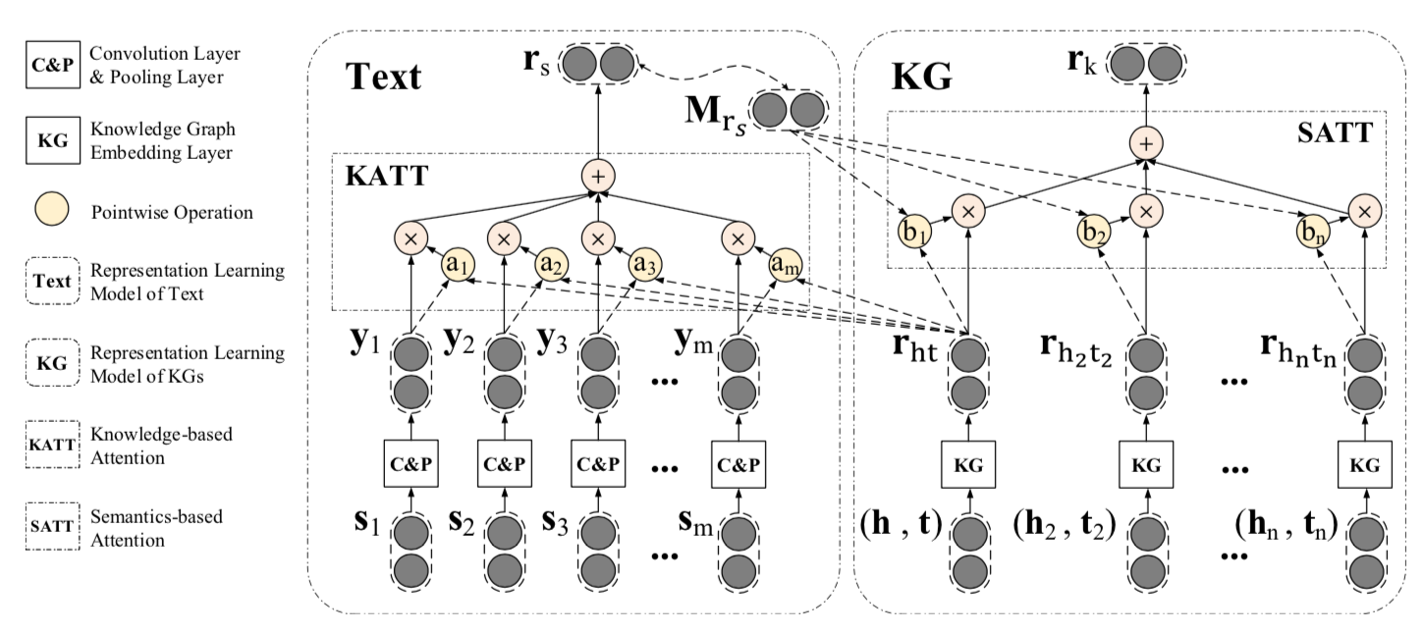
关系抽取
Xu Han, Zhiyuan Liu, Maosong Sun. Neural Knowledge Acquisition via Mutual Attention between Knowledge Graph and Text. The 32th AAAI Conference on Artificial Intelligence (AAAI 2018).

Slide 31
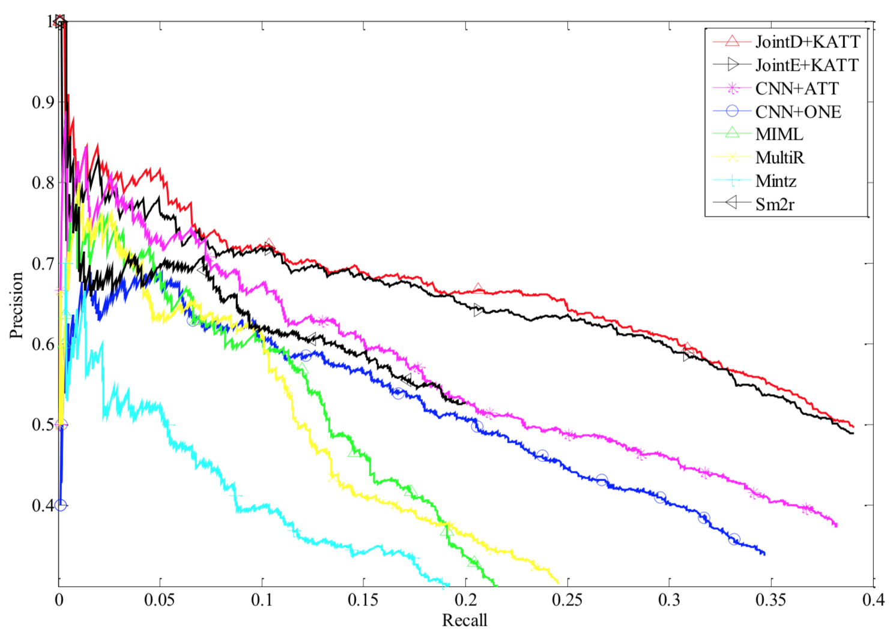
关系抽取
Xu Han, Zhiyuan Liu, Maosong Sun. Neural Knowledge Acquisition via Mutual Attention between Knowledge Graph and Text. The 32th AAAI Conference on Artificial Intelligence (AAAI 2018).

Slide 32
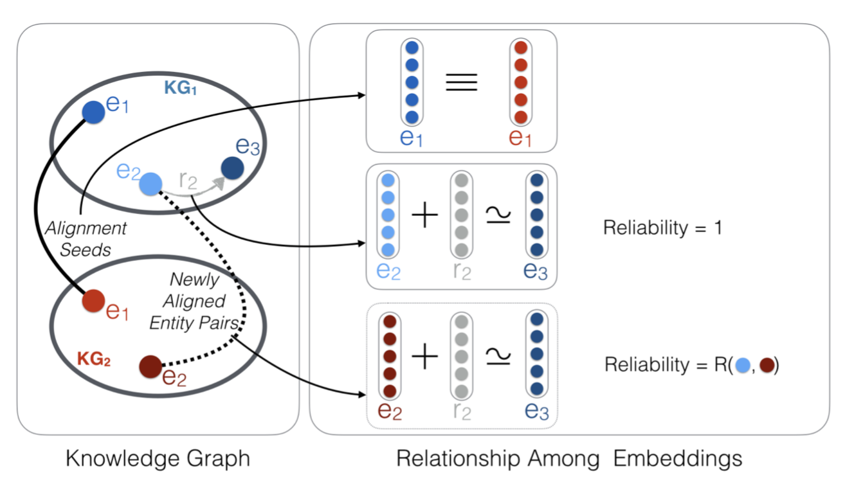
实体对齐
在两个异质KG之间，根据少量seed对齐实体，可实现大量实体对齐
分别学习两KG知识表示，建立两者映射关系
Hao Zhu, Ruobing Xie, Zhiyuan Liu, Maosong Sun. Iterative Entity Alignment via Joint Knowledge Embeddings. International Joint Conference on Artificial Intelligence (IJCAI 2017).

Slide 33
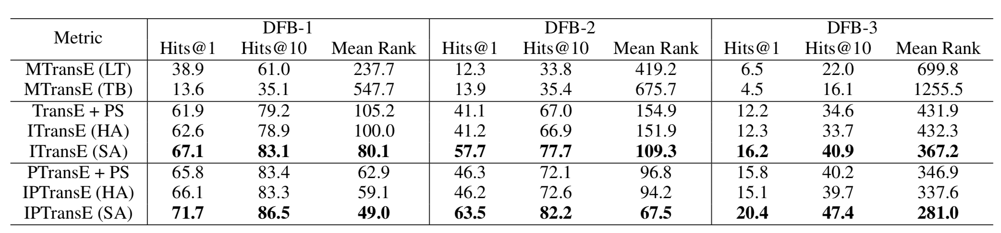
实体对齐
在两个异质KG之间，根据少量seed对齐实体，可实现大量实体对齐
分别学习两KG知识表示，建立两者映射关系
实验证明该方案能够有效提升实体对齐效果
Hao Zhu, Ruobing Xie, Zhiyuan Liu, Maosong Sun. Iterative Entity Alignment via Joint Knowledge Embeddings. International Joint Conference on Artificial Intelligence (IJCAI 2017).

Slide 34
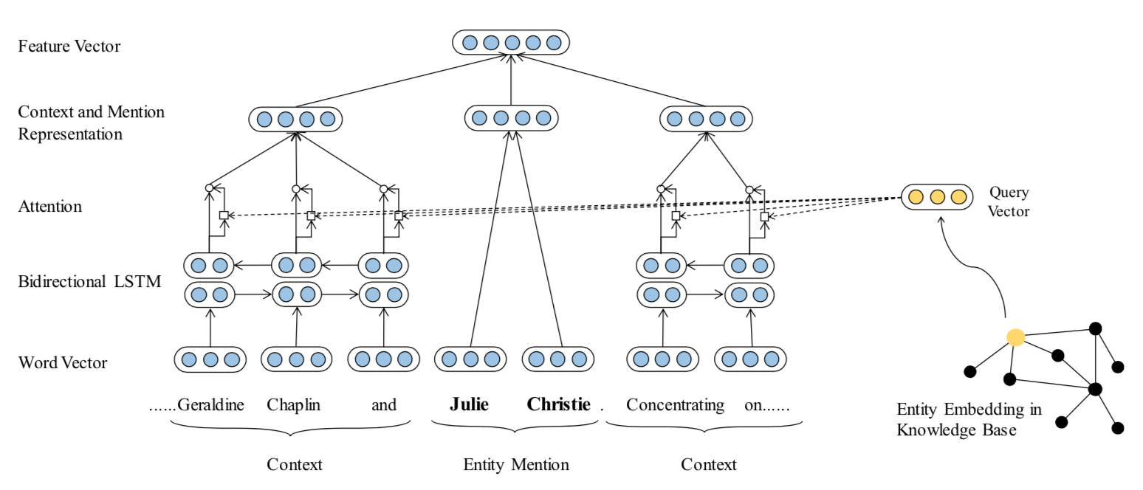
实体分类
对文本实体进行细粒度分类，助力深度分析
充分利用KG实体表示，提出知识注意力机制，建立对上下文的高效建模
Ji Xin, Yankai Lin, Zhiyuan Liu, Maosong Sun. Improving Neural Fine-Grained Entity Typing with Knowledge Attention. The 32th AAAI Conference on Artificial Intelligence (AAAI 2018).

Slide 35
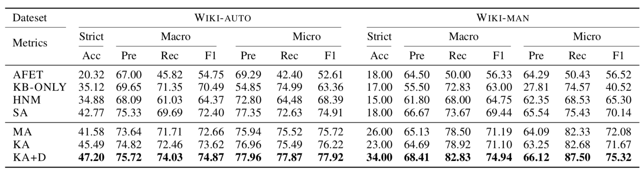
实体分类
对文本实体进行细粒度分类，助力深度分析
充分利用KG实体表示，提出知识注意力机制，建立对上下文的高效建模
显著提升实体分类性能
Ji Xin, Yankai Lin, Zhiyuan Liu, Maosong Sun. Improving Neural Fine-Grained Entity Typing with Knowledge Attention. The 32th AAAI Conference on Artificial Intelligence (AAAI 2018).

Slide 36
开源平台： OpenKE
http://openke.thunlp.org/
工具包：统一接口，包括TransE 、TransH、TransR、TransD、RESCAL、DistMult、HolE、ComplEx等算法的高效实现
表示模型：面向WikiData和Freebase两大通用KG全量数据的预训练好的知识表示模型下载

Slide 37
展望未来
利用表示学习技术将知识图谱用于相关领域
信息检索：查询-文档匹配、查询推荐、实体排序
推荐系统：用户-产品匹配
金融、医疗、法律、…
利用表示学习技术改进知识获取能力
富语境信息抽取
开放关系抽取
开放事件抽取

Slide 38
谢 谢
http://nlp.csai.tsinghua.edu.cn/~lzy/
liuzy@tsinghua.edu.cn

